Slide 1









PT Chitose Internasional Tbk
Opening Meeting
Audit SMT Q2
2025
08 Agustus 2025

Slide 2







PT Chitose Internasional Tbk
Agenda Meeting
External Audit Findings
Audit SMT Q2 - 2025

Slide 3



PT Chitose Internasional Tbk
External Audit
Findings (YTD)
2025

Slide 4



Audit Eksternal yang terlaksana:
SNI Bed Sucofindo (CPAKB);
CDAKB;
Surveillance ISO 9001, 14001 & 45001.

Slide 5
Departement | Audit | Jumlah Temuan (Mayor, Minor, Observasi)
CMS | CPAKB, CDAKB, Surveillance ISO 9001 | 16
HCGA | CPAKB, Surveillance ISO 9001, 14001 & 45001 | 8
IT | Surveillance ISO 9001 | 1
Production | CPAKB | 1
Purchasing | CPAKB | 1
QC | CPAKB | 2
RND | CPAKB | 1
Sales & Marketing | Surveillance ISO 9001 | 2
GS-NSB | CPAKB | 1

Slide 6
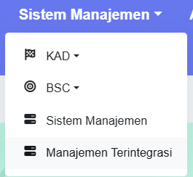

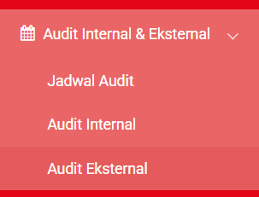
Akses: https://portal.chitose.id/
Login ke akun Portal (Manager);
Lalu klik Manajemen Terintegrasi
Pada layar web, pilih Audit Internal & Eksternal;
Lalu klik Audit Eksternal

Slide 7
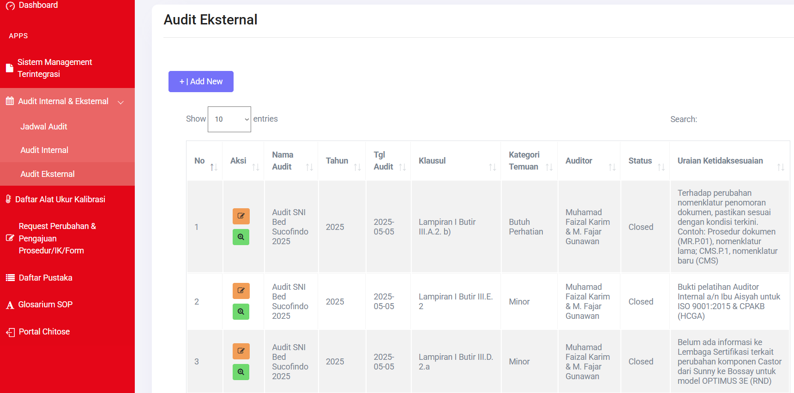

Slide 8



PT Chitose Internasional Tbk
Audit SMT
Q2 - 2025
Jadwal Audit SMT Q2 - 2025

Slide 9
PT Chitose Internasional Tbk
Opening Meeting
Audit SMT Q2
2025
08 Agustus 2025

