Slide 1
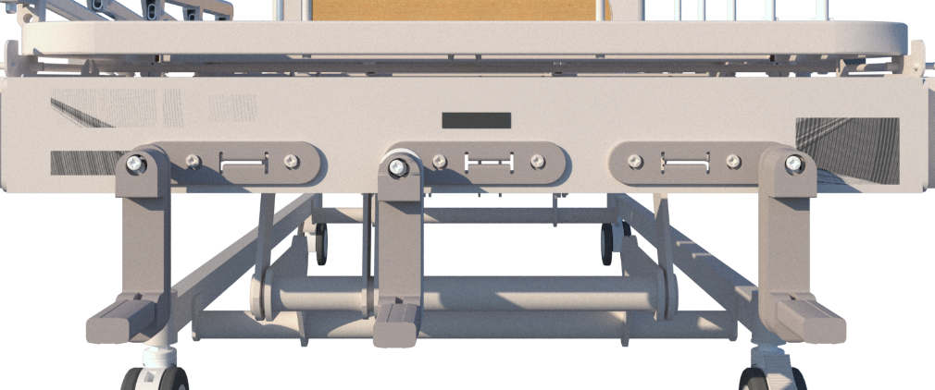





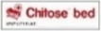
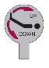
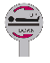
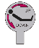
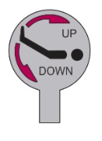
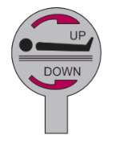

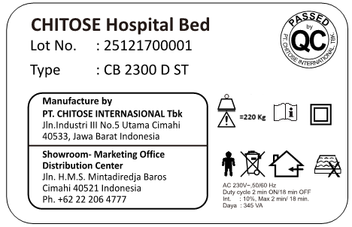
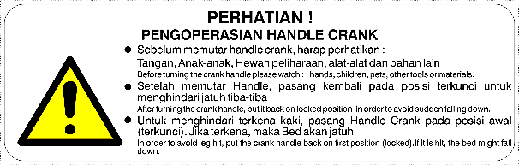
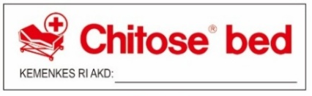

CB – 2300 D ST
CB 2300 D ST is an Electric Hospital Bed that meets your need. Suitable with Folding Side Rail and Diagonal/Dual Lock or Total Lock System. Equipped with 3 Motors Actuator Operating System as the main Mechanism to adjust the height, head, and foot position of the bed, which can be controlled by a handheld controller for Patient’s maximum comport.
Standard Function
Operating System : 3 Motor electric operation for High-Low, Head Raise and Foot Raise positions
Position : - High – low : Automatic operation with Motor
- Head Raise : Automatic operation with Motor, tilting from 0 to 80 degrees
- Foot Raise : Automatic operation with Motor, tilting from 0 to 80 degrees
Primary : - Simple design, no sharp corners (smooth surface)
- Easy operating mechanism, with Handheld controller
- Sturdy and anti-rust
- Wheels that are easy to move and position, with lock - unlock system
Lock System : Double Lock System on the Wheels
Accessories : IV Pole (2 Type Option) and Side Rail / Folding Side rail
Bed Side Cabinet, Over Bed Table, and Foot Step
Airmate Cpro Mattress / Urethane
MANUFACTURER LABEL
1
CRANK LABEL
3
2
5
4
Caution Handle operation
MANUFACTURE LABEL AND LOT NUMBER
1
Lot Number and Product Type
2
Manufacture Information
3
Maksimum Weight Sign
IZIN EDAR KEMENKES
4
Use Appropriate matress Sign See Manual Instruction Sign
Applied Part Sign, Do not Dispose as Household Waste Sign Indoor Using Only Sign
5
CAUTION LABEL

Slide 2

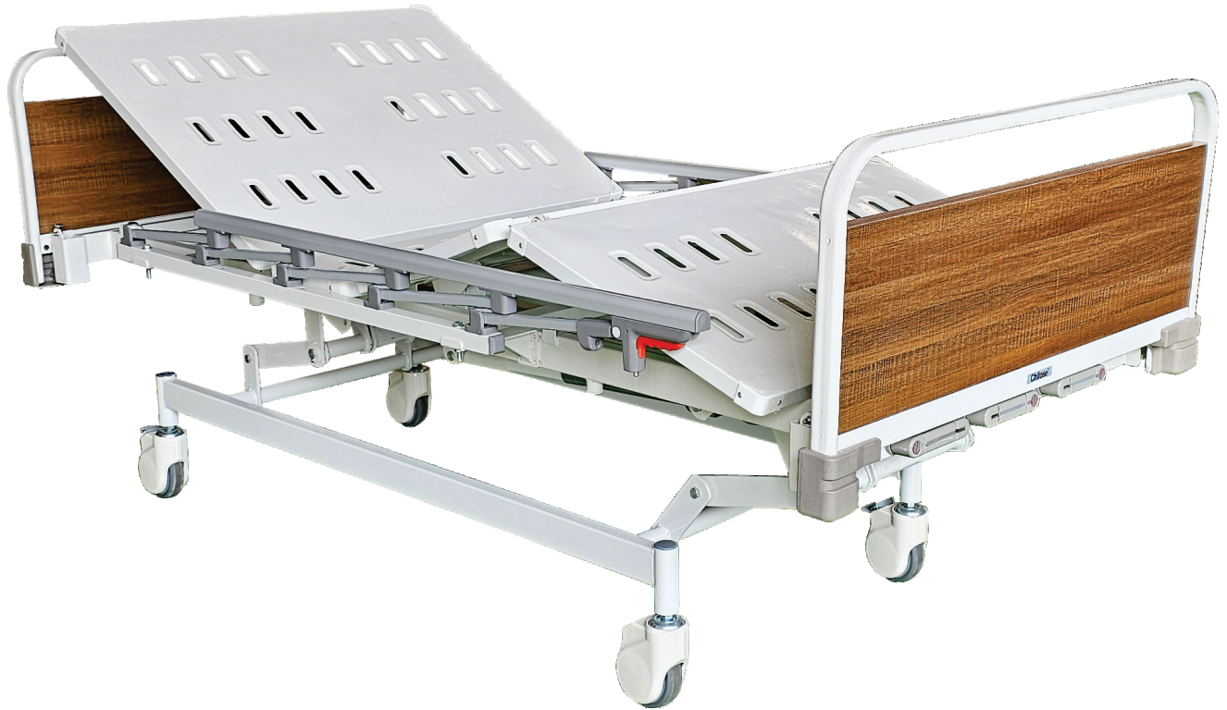

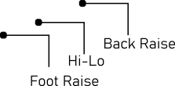



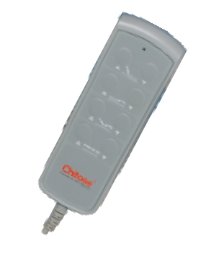
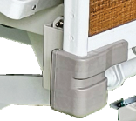
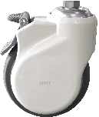
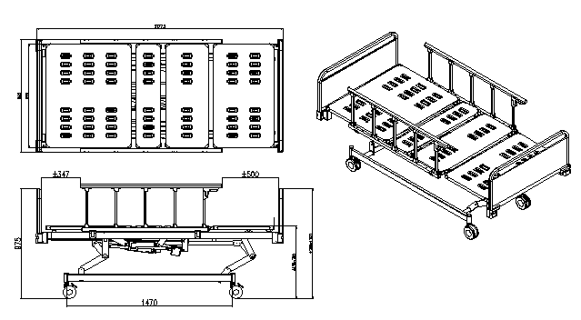

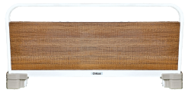
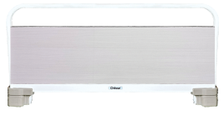
HEALTH CARE
CB-2300 D ST
(ELECTRIC BED)
CB 2300 D ST is an Electric Hospital Bed that meets your need. Suitable with Folding Side Rail and Diagonal/Dual Lock or Total Lock System. Equipped with 3 Motors Actuator Operating System as the main Mechanism to adjust the height, head, and foot position of the bed, which can be controlled by a handheld controller for Patient’s maximum comport.
Operating System : Adjustable Hi-Lo , Back Raise and Foot Raise Automaticlly by Motor
Weight (Kg) : Approx. 90
Accesorries : FSR - 001
Frame Finishing : Powder Coating
Lock System : Double Lock System
Frame Color : White
Frame Material : Steel
Dimension (mm) : Bed (W 1030, L 2230, H 760~1005)
H/F Board (W 932)
Maximum Weight Load : 220 Kg

Slide 3


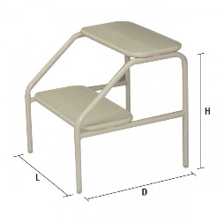
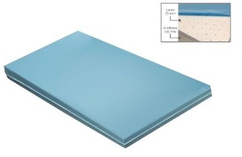
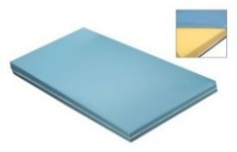



CB-2003 D ST (MANUAL 3 CRANK)
ACCESSORIES
FOLDING SIDE RAIL
FOOTSTEP
MATRESS LATEX + POLIURETAN
MATRESS POLYURETHANE
Kode FSR 001
Kode FS 001
Kode MT 005L
Kode MT 005U
TIANG INFUS 2 HOOK
TIANG INFUS 4 HOOK
Kode HR 001
Kode HR 002

